Slide 1
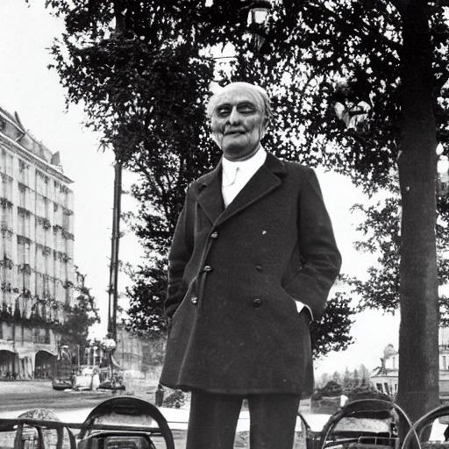
Hans Grumbach was a mild blue-eyed
smooth-faced, ruddy-cheeked,
with a brown button of a nose. He drank his
with the best of them, but it never got so far
his nose save from the outside. His suit was
but the checks were ample, and the
a little too heavy.

Slide 2
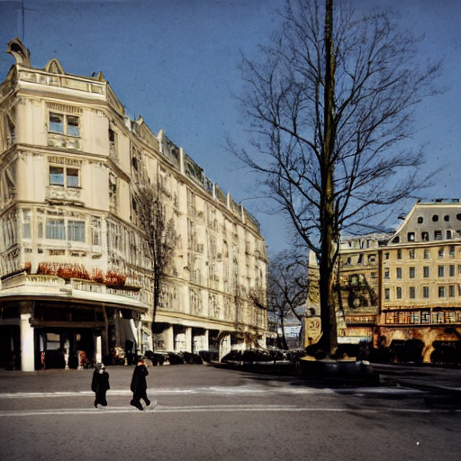
"That was his excellency, Herr Carmichael,
American consul."

Slide 3
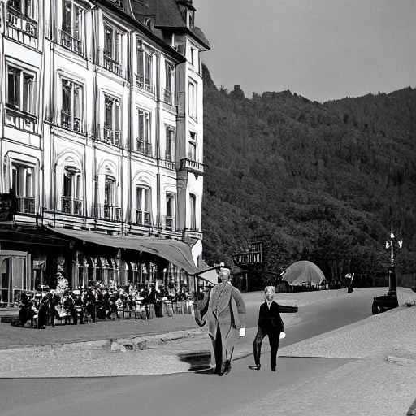
Grumbach liked the consul's smile. More than that, he recognized instantly that this
young man was a gentleman. The inherent respect for caste had not been beaten out of
blood.

Slide 4
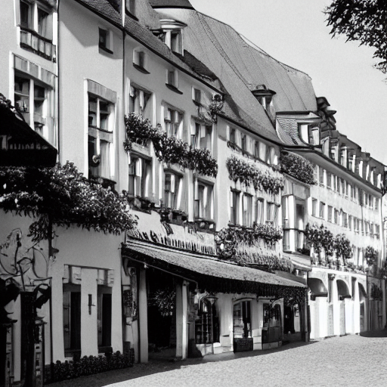
Carmichael took the papers, frowning slightly. Grumbach laid his derby on his knees. The
went over the papers and handed them to their owner.

Slide 5
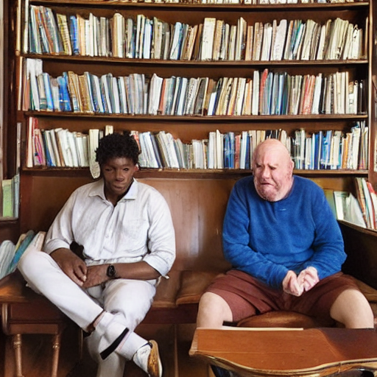
"But there's one thing, my boy," said
Carmichael.

Slide 6
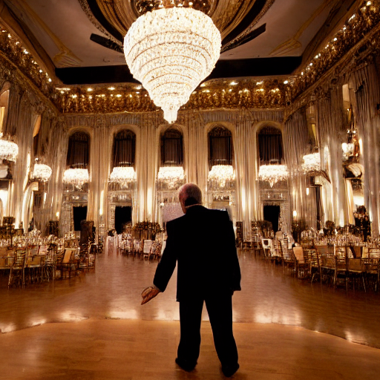
"So she is gentle and beautiful? Why not?
You should have seen her mother. She was
most beautiful woman in all Germany, and
sang like one of those Italian nightingales"

